Slide 1
Introduction To Programming

Slide 2
Content
String

Slide 3
String
C++ uses the <string.h> header file to provide the prototypes.
Most frequently used functions: strlen(), sizeof(), strcat(), strncat(), strcmp(), strncmp(), strcpy(), strncpy(), strchr(), strstr(), substr() and so on.
              #include<iostream>
              #include<string.h>
              using namespace std;

Slide 4
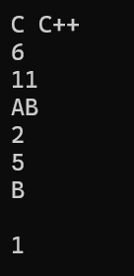
strlen(s), sizeof(s)
strlen(s) = length of the character/string only before null character
      ‘\0’ denotes the null character
sizeof(s) = size of the array/total character of the array/length of the whole string
char courses[]= "C C++ \0 C#";
cout<<courses<<endl;
cout<<strlen(courses)<<endl;
cout<<sizeof(courses)<<endl;
char sections[5] = {'A', 'B', '\0', 'C'};
cout<<sections<<endl;
cout<<strlen(sections)<<endl;
cout<<sizeof(sections)<<endl;
cout<<sections[1]<<endl;
cout<<sections[2]<<endl;
cout<<sizeof(sections[2])<<endl;

Slide 5
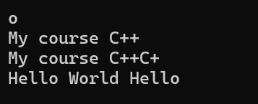
strcat(s1, s2), strncat(s1, s2, n)
strcat(s1, s2) = Adding all the characters of two strings and stores in s1
strncat(s1, s2, n) = Adding s1 with s2’s n^{th} position and stores in s1
‘\0’ concept is applicable for both strcat(s1, s2) and strncat(s1, s2, n)
The + operator can be used between strings to add them together to make a new string. This is called concatenation.
char course1[]= "My course \0is: ";
cout<<course1[4]<<endl;
char course2[]= "C++";
strcat(course1, course2);
cout<<course1<<endl;
strncat(course1, course2, 2);
cout<<course1<<endl;
string name1 = "Hello ";
string name2 = "World ";
string name3 = name1+name2+name1;
cout<<name3<<endl;

Slide 6

strcmp(s1, s2)
Compare the ASCII value of two strings character and show-
  0 if two strings are equal
  1 if s1 is greater than s2
  -1 if s1 is smaller than s2
‘\0’ concept is applicable here
ASCII chart- ASCII Table
  A < B <…< Y < Z
  a < b <…< y < z
  capital letter < small letter
  null = 0
  space = 32
  A = 65
  a = 97
  A <<< Z a <<< z capital letter <<< small letter
cout<<strcmp("SHE","SHE")<<endl;
cout<<strcmp("HE","SHE")<<endl;
cout<<strcmp("SHE","HE")<<endl;
cout<<strcmp("HEE","SHE")<<endl;
cout<<strcmp("HE", "he")<<endl;
cout<<strcmp("he","HE")<<endl;
cout<<strcmp("SHe","She")<<endl;
cout<<strcmp("SHE","\0HE")<<endl;
cout<<strcmp("\0HE","SHE")<<endl;

Slide 7

strncmp(s1, s2, n)
Difference of two strings ASCII value till n^{th} position and show-
  0 if ASCII value difference is zero till n^{th} position
  Positive (+ve) or negative (-ve) depends on the ASCII value difference till n^{th} position
  (s1 – s2)
  n is a positive integer that limits the number of characters to be compared.
‘\0’ concept is applicable here
ASCII chart- ASCII Table
  A < B <…< Y < Z
  a < b <…< y < z
  capital letter < small letter
  null = 0
  space = 32
  A = 65
  a = 97
Ignore Code::Blocks
Use Programiz online compiler
cout<<strncmp("SHE","SHE",1)<<endl;
cout<<strncmp("HE","SHE",1)<<endl;
cout<<strncmp("SHE","HE",1)<<endl;
cout<<strncmp("HEE","SHE",1)<<endl;
cout<<strncmp("HE", "he",1)<<endl;
cout<<strncmp("he","HE",1)<<endl;
cout<<strncmp("SHe","She",1)<<endl;
cout<<strncmp("SHe","SHE",2)<<endl;
cout<<strncmp("SHe","SHE",3)<<endl;
cout<<strncmp("SHe","SH\0",3)<<endl;

Slide 8
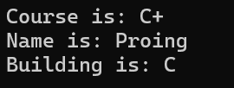
strcpy(s1, s2), strncpy(s1, s2, n)
strcpy(s1, s2) = Copy s2 to s1
strncpy(s1, s2, n) = Copy s2’s n^{th} position to s1’s n^{th} position
‘\0’ concept is applicable here
char course1[]= "C+\0C++";
char course2[5];
strcpy(course2, course1);
cout<<"Course is: "<<course2<<endl;
char name1[] = "Programming";
char name2[] = "Coding";
strncpy(name2, name1, 3);
cout<<"Name is: "<<name2<<endl;
char c1[] = "C \0building";
char c2[] = "D building";
strncpy(c2,c1,3);
cout<<"Building is: "<<c2<<endl;

Slide 9

strchr(s1, c1), strstr(s1, s2)
strchr(s1, c1) = Find the c1 from s1 and show till last including c1
strstr(s1, s2) = Find the s2 from s1 and show till last including s2
‘\0’ concept is applicable here
cout<<strchr("AIUB",'I')<<endl;
cout<<strchr("AI\0UB",'I')<<endl;
cout<<strstr("AIUB","IU")<<endl;
cout<<strstr("AI\0UB","AI")<<endl;

Slide 10
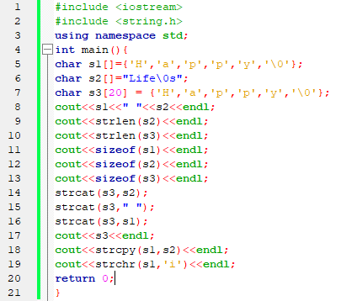
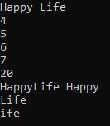
Find the output…

Slide 11
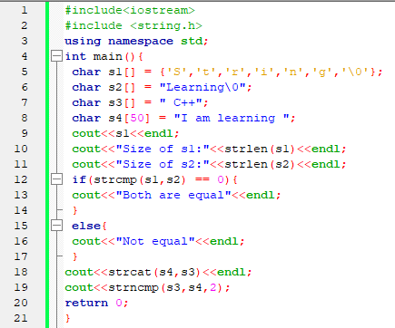

Find the output…

